Slide 1





SOCIAL BUZZ
Notes:
22.03.2024
1

Slide 2


TODAY'S AGENDA
Project recap
Problem
The Analytics team
Process
Insights
Summary
Notes:
22.03.2024
2

Slide 3

Social Buzz is a fast growing technology unicorn that need to adapt quickly to it’s global scale.
Accenture has begun a 3 month POC Focusing on these tasks:
An audit of Social Buzz’s big data practice
Recommendations for a successful IPO
Analysis to find Social Buzz’s top 5 most popular categories of content
PROJECT RECAP
Notes:
22.03.2024
3

Slide 4



PROBLEM
OVER 100000 POSTS PER DAY
36,500,000 PIECERS OF CONTENT PER YEAR!
But how to capitalize on it when there is so much?
Analysis to find Social Buzz’s top 5 most popular categories of content
Notes:
22.03.2024
4

Slide 5




ANDREW FLEMING
Chief Technical Architect
THE ANALYTICS TEAM
MARCUS ROMPTON
Senior Principle
SKILLSPIRESS
Chief Technical Architect
Notes:
22.03.2024
5

Slide 6



PROCESS
Data Understanding
1
Data Cleaning
2
Data Modelling
3
4
Data Analysis
5
Uncover Insights
Notes:
22.03.2024
6

Slide 7

INSIGHTS
16
ANIMAL
MAY
Unique Categories
Most Favorite Category
With Most Number of Posts
Notes:
22.03.2024
7

Slide 8

Notes:
22.03.2024
8

Slide 9
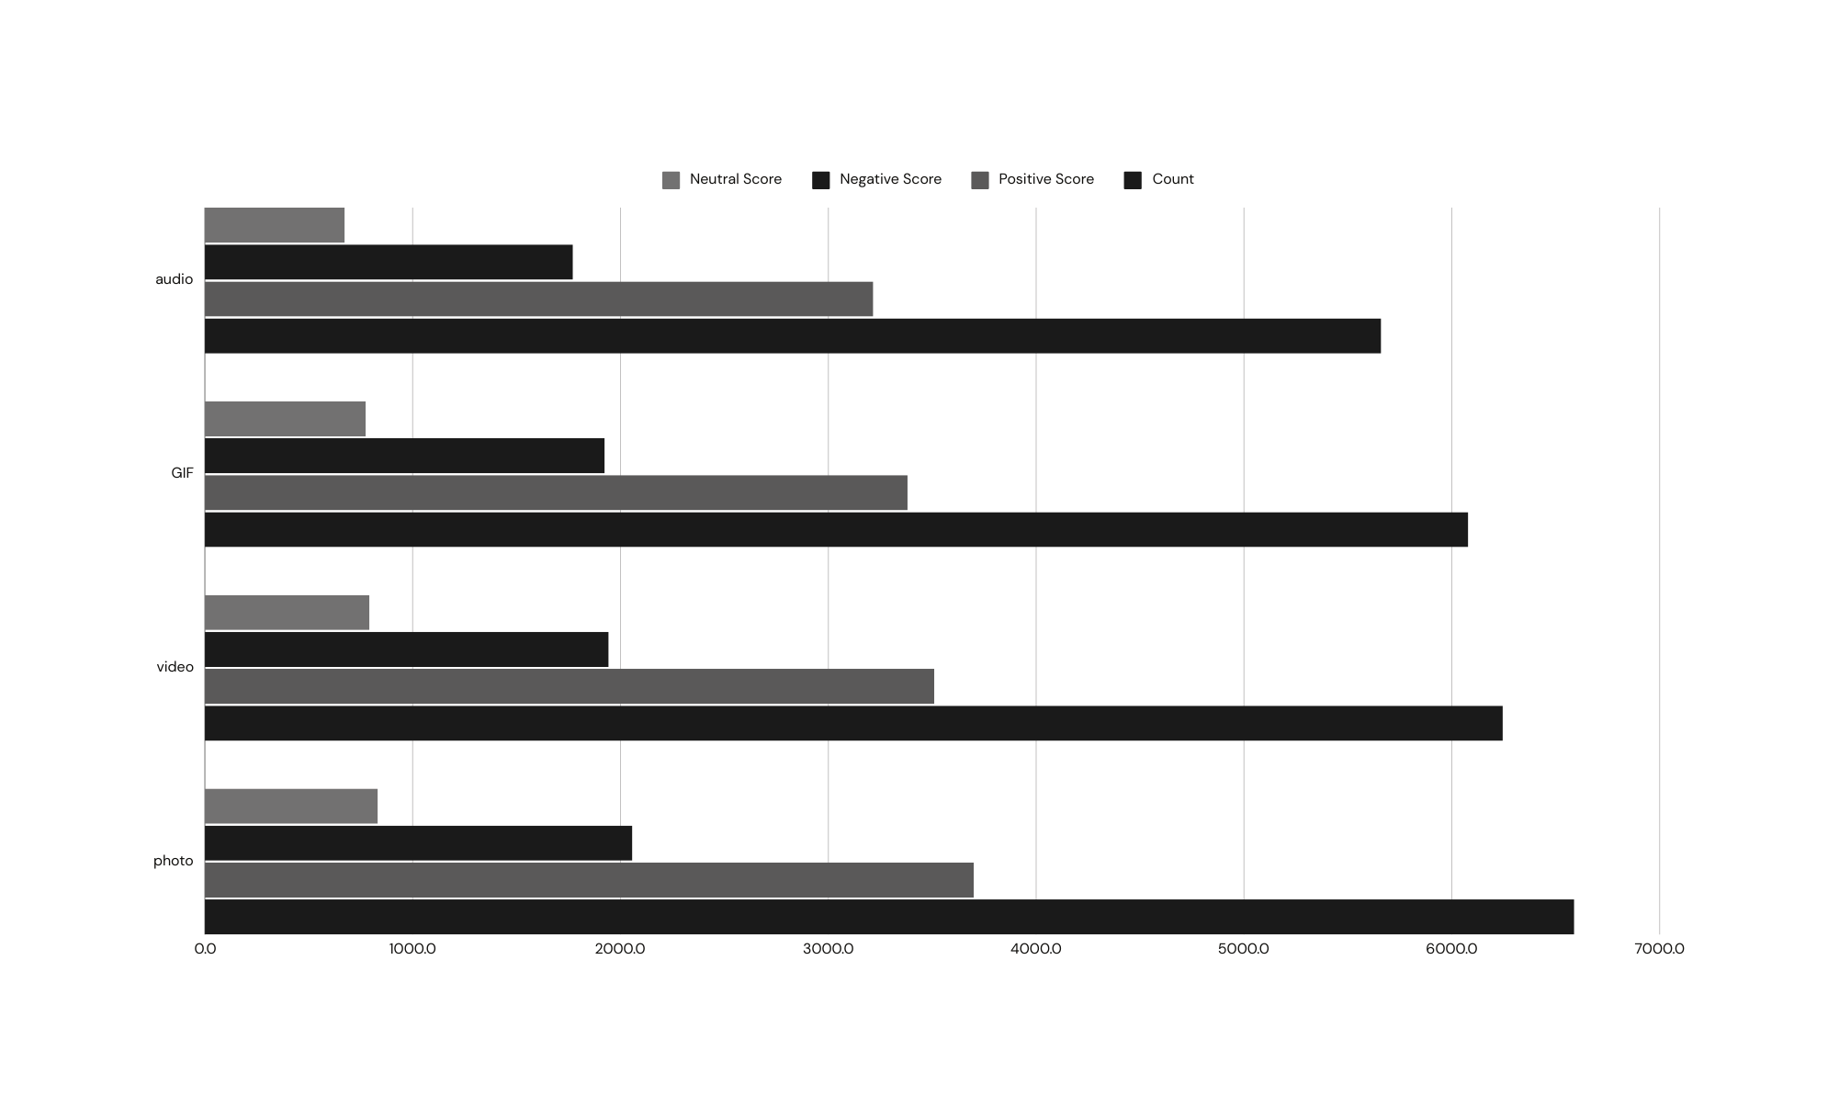
Notes:
22.03.2024
9

Slide 10


There are a total of 16 distinct content categories. Out of which Animal and Science categories are the most popular one.
4 types of content- Photo, Video, GIF and Audio, out of which people prefer photo and video the most.
May month has the highest number of posts and stands at 2138 posts , while February month has the lowest number of posts (1914 Posts)
Conclusion
Social Buzz should focus more on the top 5 categories that’s Animal, Technology, Science, Healthy eating and food and can create campaign to specifically target those audiences
Social Buzz can need to maximize in the month of January , May and August as they number of posts in these months are the highest.
SUMMARY
Notes:
22.03.2024
10

Slide 11

THANK YOU!
ANY QUESTIONS?
Notes:
22.03.2024
11

